Slide 1
Classifying Reddit Posts into their Subreddits
Bala Krishnamoorthy

Slide 2
Contents
Facts about “the front page of the internet”
Problem Statement
Methodology
Modelling: Process
Modelling: Performance
Conclusion
Next Steps

Slide 3
Facts about “the front page of the internet”
Widespread popularity
330 million monthly active users
~62% of users visit Reddit for news
160,000 pages are viewed per minute
More than 1 million subreddits (June 2017)
Founded by Alexis Ohanian and Steve Huffman
Initially popularized the site by creating many fake profiles and comments
A place of wonder and chaos
r/secretsanta (world’s largest)
r/showerthoughts
r/ roastme

Slide 4
Problem Statement
Given a post from one of two subreddits, can we build a model that predicts which subreddit the post came from?
“Watching a graduation ceremony is like sitting through an entire movie that’s end credits”
Post:
Subreddits:
r/showerthoughts
r/DeepPhilosophy
Why solve this problem? To evaluate the strengths and weaknesses of NLP classification tools.

Slide 5
Methodology
Data gathering
Access reddit’s API, and collect reddit posts
Data cleaning
Extract text content from each reddit post
Modelling
Build helper functions
NLP: text vectorization
Run and evaluate several classifiers
Visualize Results

Slide 6
Modelling: Process
Vectorizer:
Count Vectorizer
Grid Search
Hyperparameter Tuning
Classifier:
TFIDF Vectorizer
Logistic Regression
Random Forest
SVC
MultinomialNB
Data Pipeline

Slide 7
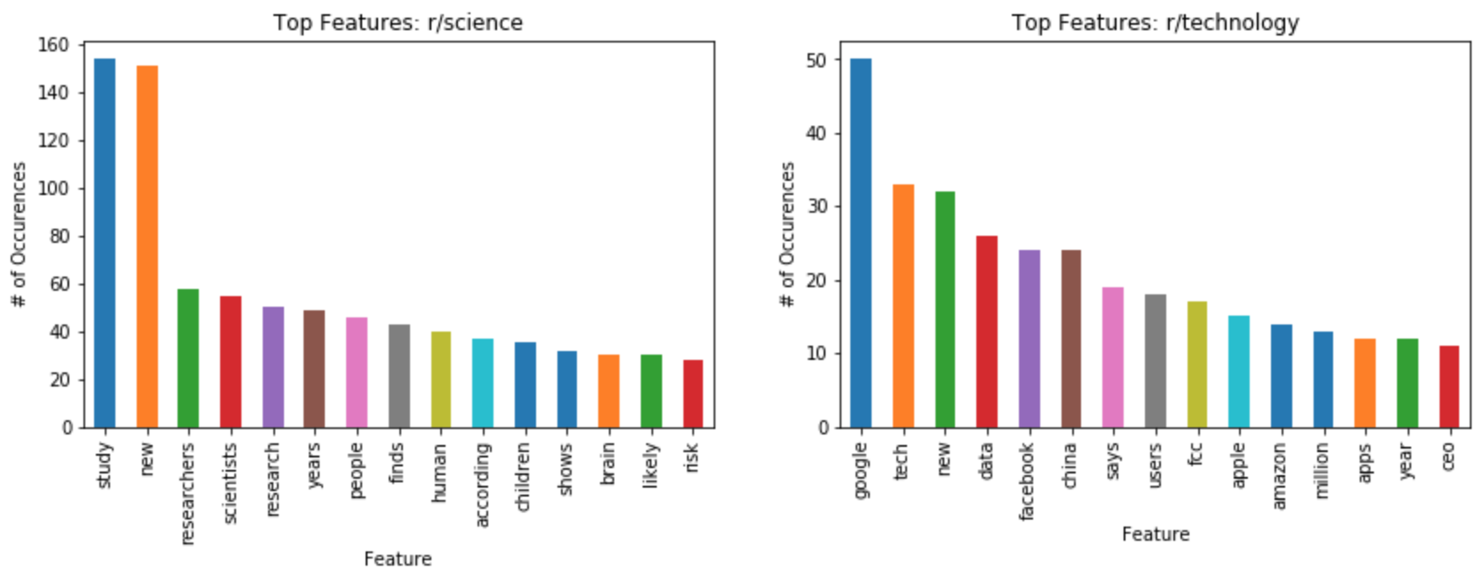
Modelling: Performance (part 1)
r/science vs r/technology
Baseline Accuracy: 62%
Score Type | CV + LogReg | CV + RandomForest | CV + MultinomialNB | TFIDF + SVC
Cross-Val | 92% | 88% | 93% | 91%
Test | 91% | 88% | 92% | 92%

Slide 8
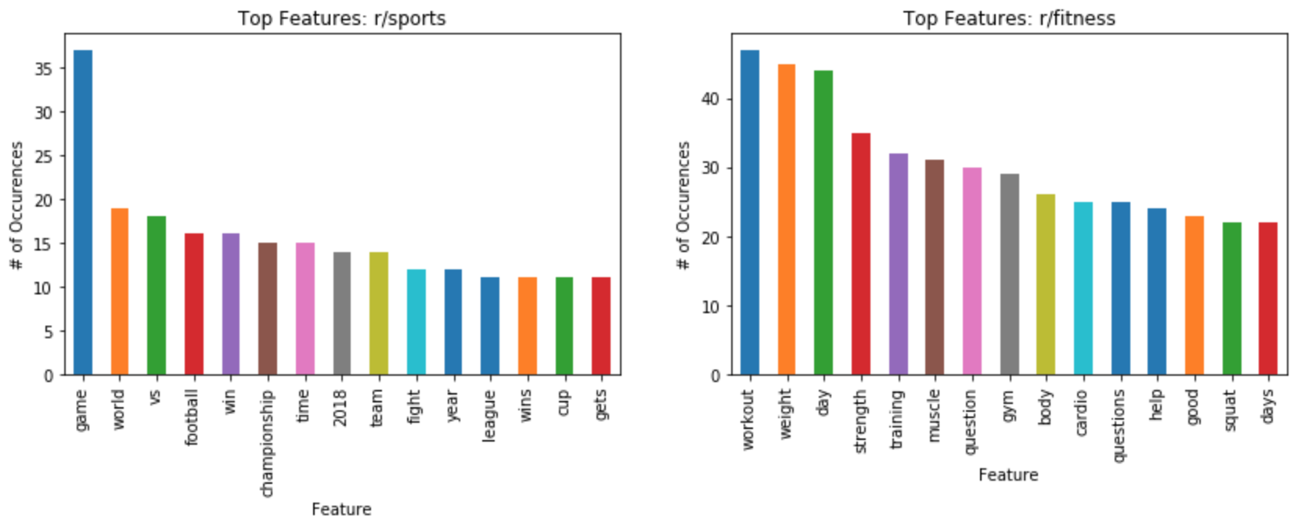
Modelling: Performance (part 2)
r/sports vs r/fitness
Baseline Accuracy: 64%
Score Type | CV + MultinomialNB | TFIDF + SVC
Cross-Val | 96% | 95%
Test | 96% | 95%
No common features in Top 15

Slide 9
Conclusion
NLP is powerful
Relatively simple pipelines can produce accurate, reliable results
As one would expect, the model performs better when there are more distinct differences between subreddits

Slide 10
Next Steps
Test the model on very similar subreddits
And compare against human performance! ☺
In this project, NLP was conducted solely on the “title” block within the post
We can expand our NLP curtain to include any text not within the “title” block, comments, urls of links embedded within posts, etc.
Combine numerical and text features (e.g. number of comments per post and text within comments)
Automate model selection and hyperparameter tuning

Slide 11
Questions?

